Slide 1



Atliq Hardware Sales Analysis 2016 to 2019
View in Power BI
Last data refresh:
8/17/2024 10:13:42 AM UTC
Downloaded at:
8/17/2024 10:42:03 AM UTC

Slide 2
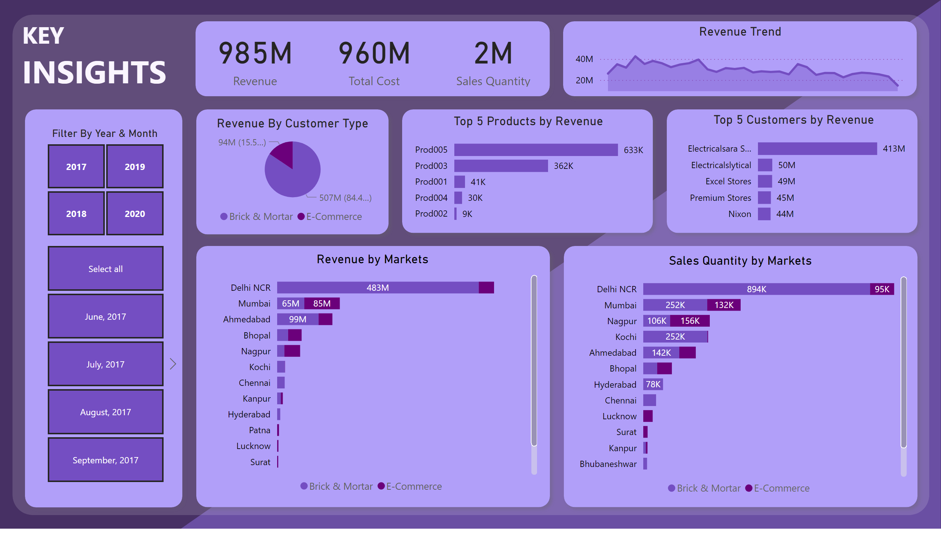
Key Insights
Notes:
Revenue by Markets
No alt text provided
shape
No alt text provided
Sales Quantity by Markets
No alt text provided
shape
No alt text provided
Top 5 Products by Revenue
No alt text provided
shape
No alt text provided
Revenue By Customer Type
No alt text provided
shape
No alt text provided
Top 5 Customers by Revenue
No alt text provided
shape
No alt text provided
card
No alt text provided
card
No alt text provided
card
No alt text provided
shape
No alt text provided
Revenue Trend
No alt text provided
shape
No alt text provided
textbox
No alt text provided
Filter By Year & Month
No alt text provided
slicer
No alt text provided
shape
No alt text provided
shape
No alt text provided
shape
No alt text provided

Slide 3
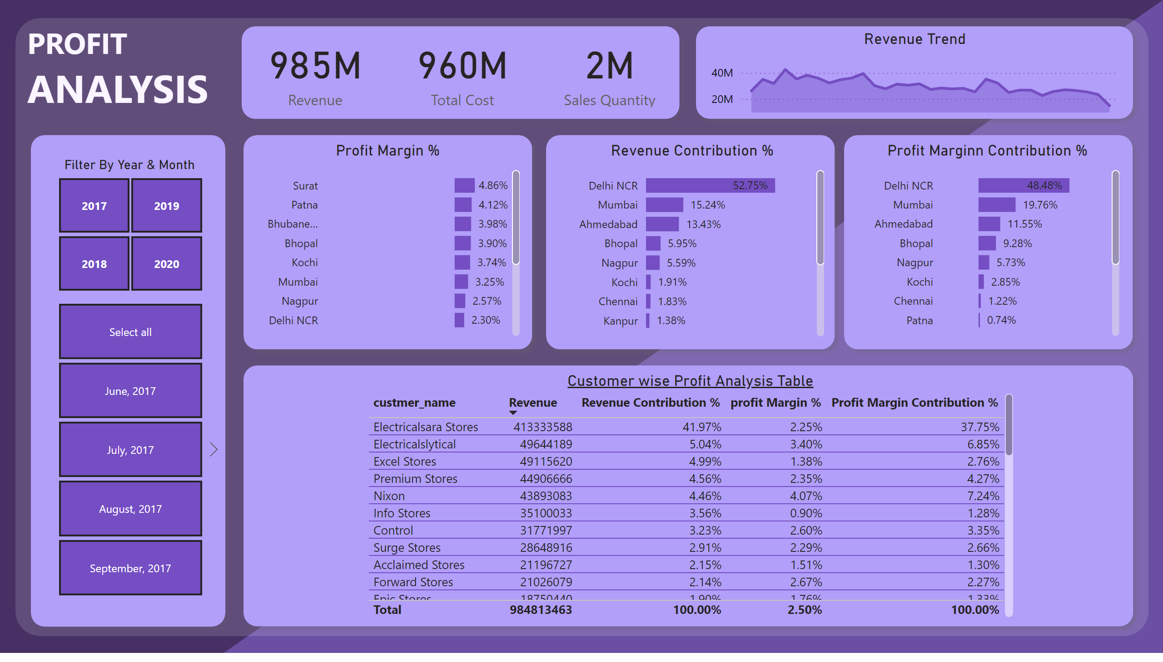
Profit Analysis
Notes:
shape
No alt text provided
Customer wise Profit Analysis Table
No alt text provided
card
No alt text provided
card
No alt text provided
card
No alt text provided
shape
No alt text provided
Revenue Trend
No alt text provided
shape
No alt text provided
textbox
No alt text provided
Filter By Year & Month
No alt text provided
slicer
No alt text provided
shape
No alt text provided
shape
No alt text provided
shape
No alt text provided
Profit Margin %
No alt text provided
shape
No alt text provided
Revenue Contribution %
No alt text provided
shape
No alt text provided
Profit Marginn Contribution %
No alt text provided
shape
No alt text provided

Slide 4
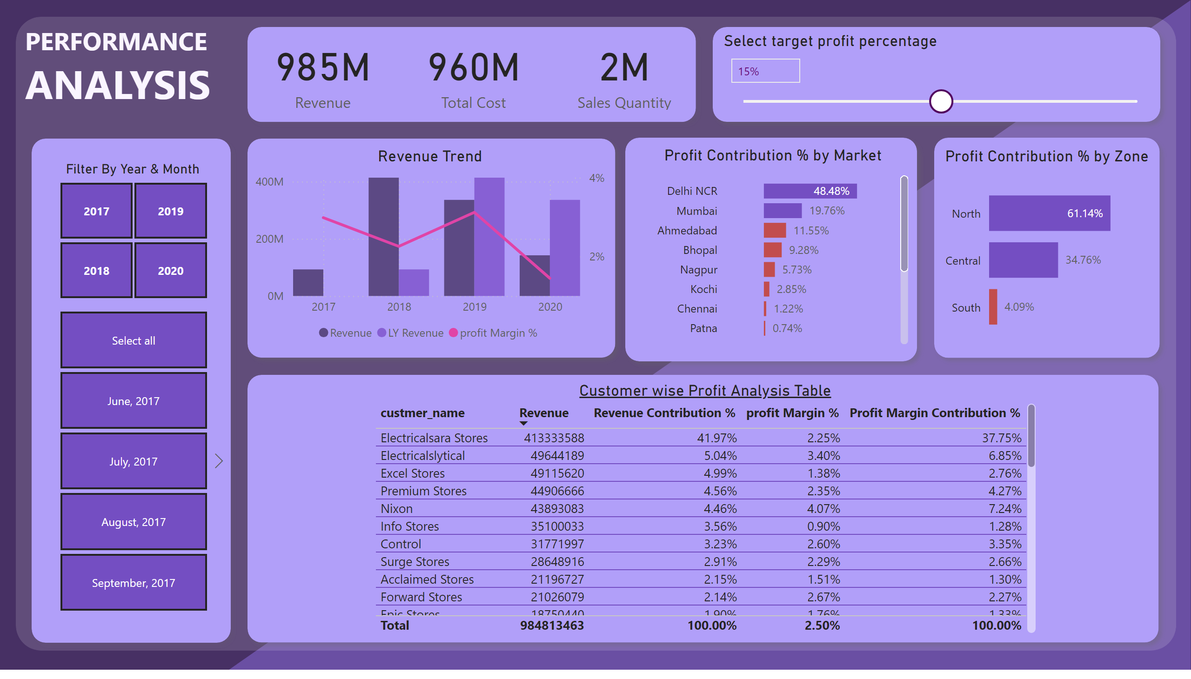
Performance Analysis
Notes:
shape
No alt text provided
shape
No alt text provided
card
No alt text provided
card
No alt text provided
card
No alt text provided
shape
No alt text provided
shape
No alt text provided
textbox
No alt text provided
Filter By Year & Month
No alt text provided
slicer
No alt text provided
shape
No alt text provided
shape
No alt text provided
shape
No alt text provided
Profit Contribution % by Zone
No alt text provided
Profit Contribution % by Market
No alt text provided
Select target profit percentage
No alt text provided
Revenue Trend
No alt text provided
shape
No alt text provided
shape
No alt text provided
Customer wise Profit Analysis Table
No alt text provided

